Slide 1

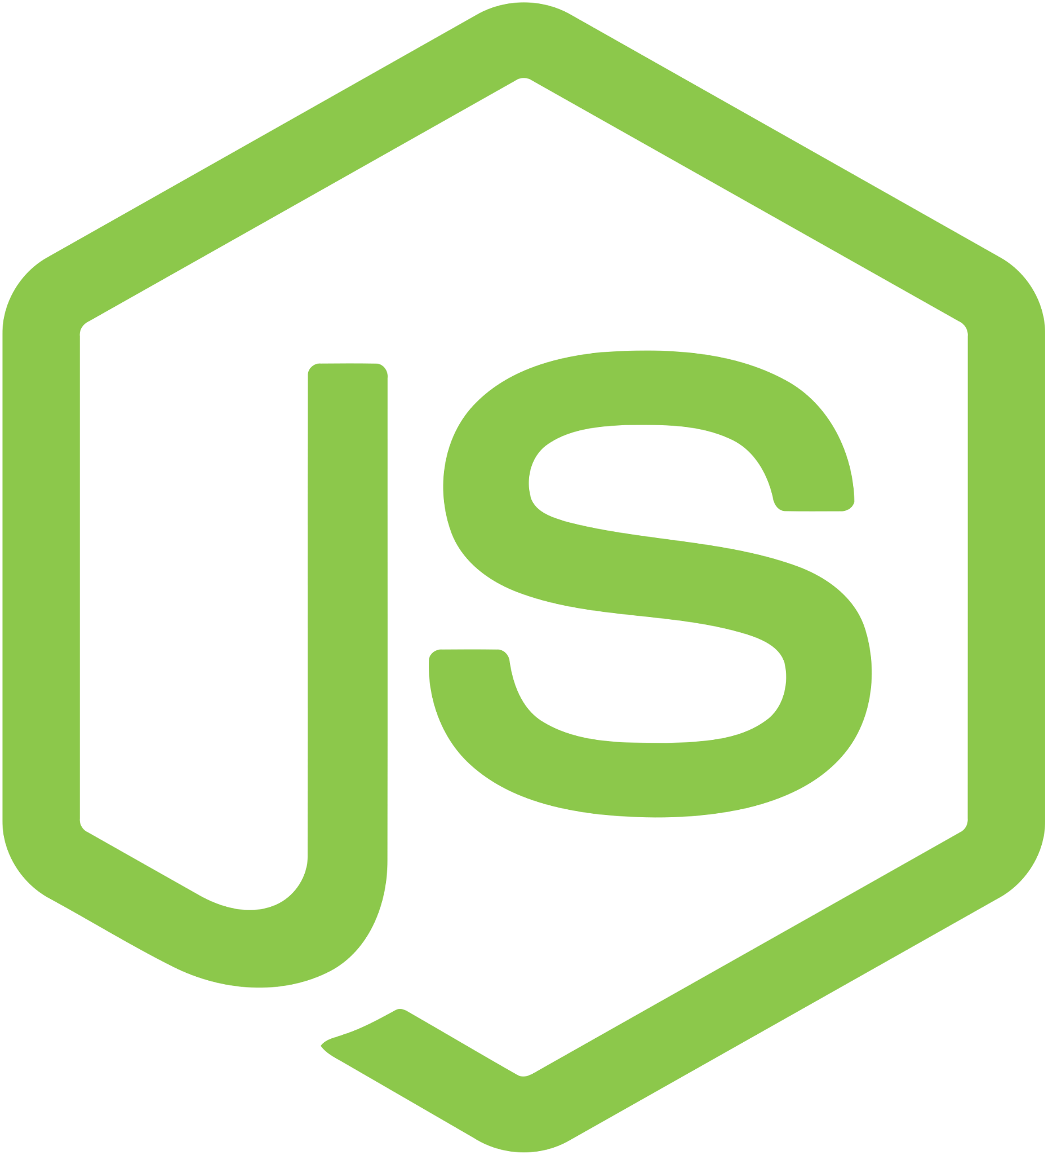
Node.js Workshop

Slide 2

Summary
What is Node.js ?
Node.js vs JavaScript
Node.js Basics
Node Modules
File System & I/O
HTTP Manipulation

Slide 3
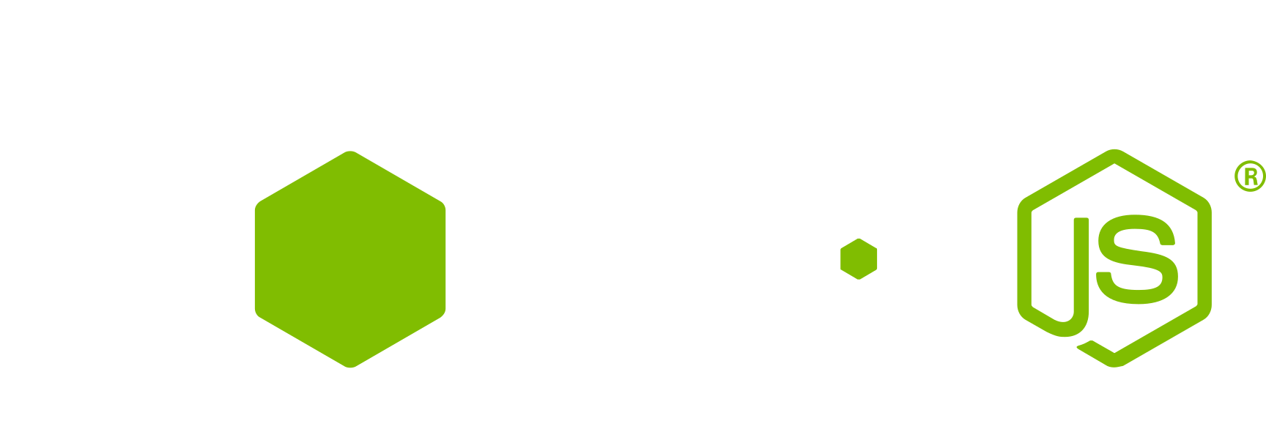
What is Node.js ?
Node.js is a cross-platform and open source asynchronous JavaScript runtime environment built on Chrome’s V8 JavaScript engine.

Slide 4

Node.js vs JavaScript
Run on Browser
Frontend Tool
Global Object: window
Access to DOM
Run on Server
Backend Tool
Global Object: global
Access to Filesystem

Slide 5

Node.js Basics
Let’s do some magic

Slide 6
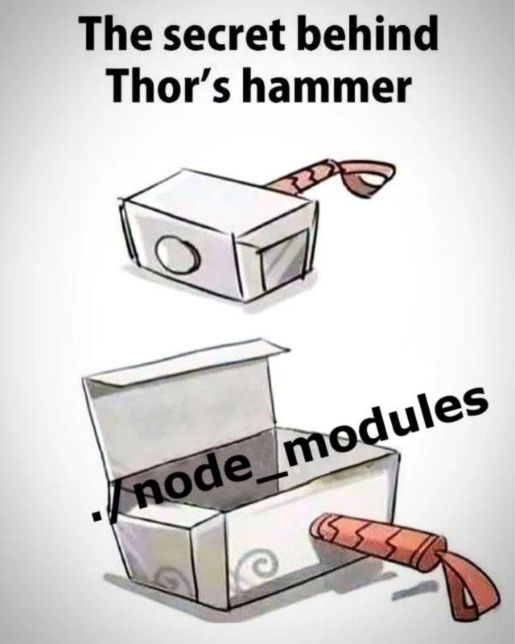
Node Modules
A module is a JavaScript library that contains variables, classes and functions. There are 3 types of modules: built-in modules, custom modules and npm packages.

Slide 7
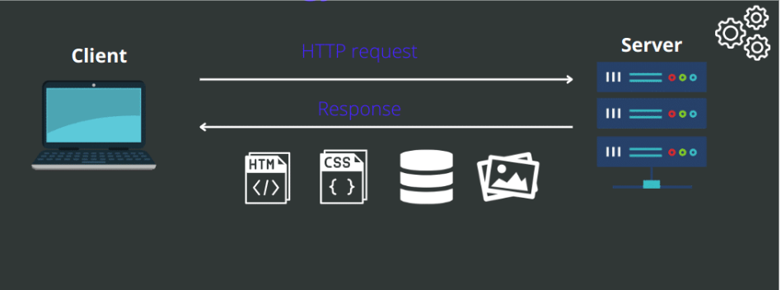
HTTP Manipulation

Slide 8
Let’s create a basic server side app

Slide 9

That’s all for today
Any questions ?

